Slide 1
VBA for Excel
Ecole de management Leonard de Vinci
Session 5
Achraf Seddik
seddik.achraf.1@gmail.com

Slide 2
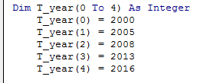
Arrays (Tables)
Arrays allow to manage easily a data set (generally of the same type)
Lesson Objectives :
Create an Array, assign values to it, display its content.
Know how to carry out basic operations on a data table.
Note : loops will be used to carry these operations
Syntax example :
We declare an Array by giving it :
A name (here “T_year”),
The range of the array (here 0 to 4)
The type of data it will contain (here integer)
Note : Indexes starts at zero by default : T_year(4) = T_year(0 to 4)
Note : We can force indexes to start at another value (for i = 1 to 5)
Note : We can access arrays using for loops (here for i = 0 to 4)

Slide 3
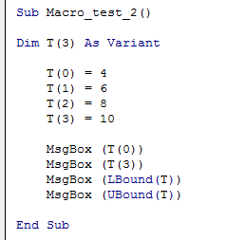
Arrays (Tables)
Useful functions on Arrays :
Erase (T_year) : to delete an array
Lbound (T_year) : returns 0
Ubound (T_year) : returns 4
Example :
What does this macro display ?

Slide 4
Lesson 5 Functions

Slide 5
Functions
Functions are subroutines that can be used in a main program
Usefulness :
Large macros (many lines of code): Function can be used to structure the code in a main program and many subroutines
Macros that perform repetitive tasks : the lines of code that perform repetitive tasks can be placed in a function that will be called several times by the main macro.
Macros developed by several developers : each developer creates a function
Note :
Once a function is created in VBA, it can be used as the predefined functions in Excel. It can be used by using the Insert Function menu.
Each function name must be unique
Lesson Objectives :
Create a function, call it in a macro and display its result.
We will use function

Slide 6
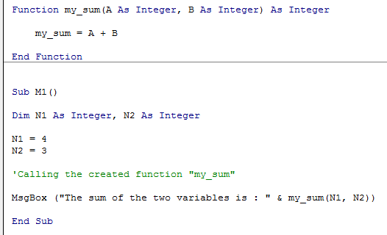
Functions
Declaring the Function
Start syntax : “Function”
Name of the function : “my_sum”
Arguments : The parameters that the function will use and their types (here A as integer and B as integer). Can be left optional
The instructions that the function will execute
The type of the result of the function (here integer)
End syntax : “End function”
Calling the function
Use the function’s name (with the input arguments) in the main macro
Note : the name of the function’s arguments holds only in the frame of the function’s declaration
Example :

Slide 7
Note : a function is :
either a subroutine (just dispatch someting that can be done within the sub) (e.g. bring data); here there are no arguments
Or : a function with arguments e.g. B&S model (A, B, C declared) and the function computes them using a formula

Slide 8
Applications Exercice Sheet N°5

